Slide 1
We Cannot Walk Alone
Summer 2022 project

Slide 2
Our aim as a trust
This summer, we will be starting a project around the theme of refugees and displacement all around the world. Our aim is to equip the children with the skills and knowledge around displacement, asylum seekers and refugees. As an ongoing problem around the world, we want our children to understand reasons why some people are forced to leave their homes to find safety elsewhere and what they can do to support them. We believe that, as a Christian school with a Christian vision, we need to show consideration to vulnerable communities and create change for those with the highest need.

Slide 3
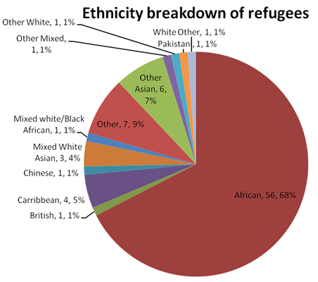
Refugees in Barking and Dagenham breakdown
Asylum seeker means to be a person who has applied for asylum under the 1951 Refugee Convention on the Status of Refugees on the grounds that they have a well-founded fear of persecution should they return to their home country.
‘Refugee’ means an asylum seeker whose claim has been successful.

Slide 4
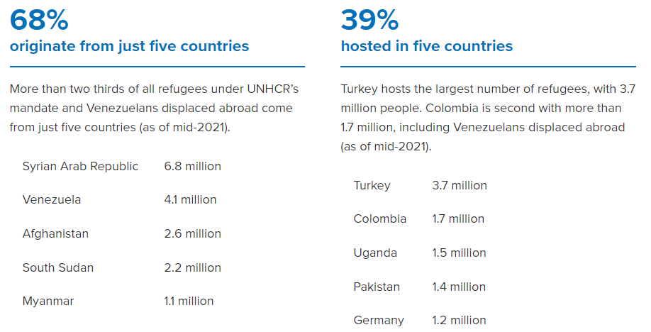
Statistics

Slide 5
What we are doing as a trust
Educating our children about the current climate so they can make informed decisions
Working with charities to house refugees
Supporting refugees and asylum seekers by raising money and donating clothes and food.

Slide 6
St. Margaret’s vision
Training children to be confident, independent learners with enquiring minds, a life-long love of learning and an approach to life that reflects core biblical values and principles.
Christian vision:
Proverbs 22:6 'Train up a child in the way he should go: and when he is old, he will not depart from it.'

Slide 7
We Cannot Walk Alone Literacy lessons
Children will be participating in a range of lessons where we will be focusing on key books that surround these topics. Our reading and writing lessons will tune into books that will engage children about the topic.
Year 1 My name is not refugee – Kate Milner and Refuge – Anne Booth and Sam Usher
Year 2 The Journey – Francesca Sanna and Wisp – Zana Fraillon and Grahame Baker Smith

Slide 8
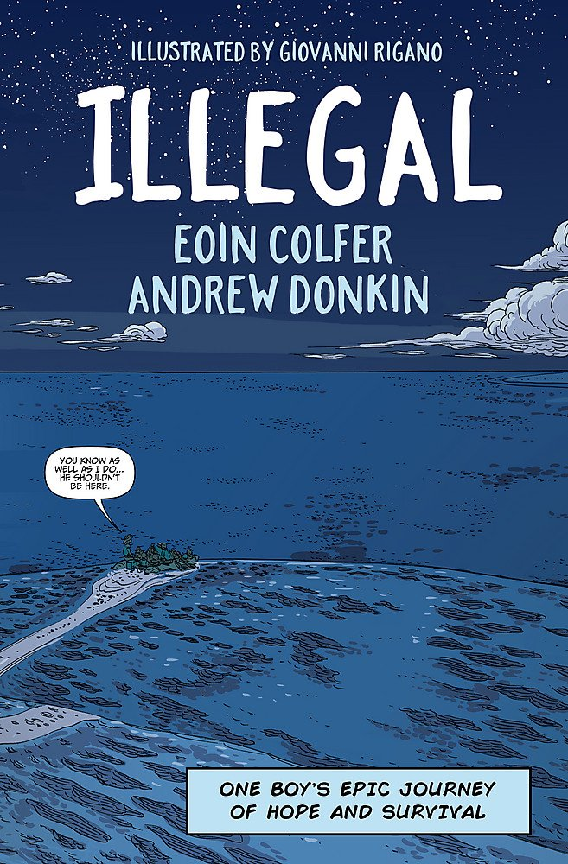
We Cannot Walk Alone KS2 Literacy lessons
Year 3 Azzi in between – Sarah Garland
Year 6 Refugee boy – Benjamin Zephaniah and Illegal – Eoin Colfer and Andrew Donkin
Year 4 On the move – Michael Rosen
Year 5 The boy at the back of the class – Onjali Q. Rauf

Slide 9
How can you
?

Slide 10
We Cannot Walk Alone- Pupil Quiz Night!
As a school community, we value parental involvement; our aim is to create some amazing opportunities for the children, where we hope you can help us to raise money for an incredible cause!
The first of our fundraising events, will be held on Thursday the 29th (Reception- Year 2) and Friday the 30th of June (Year 3-6). We will be hosting our very own quiz night - with lots of fun-filled activities for the children to enjoy. You can help by giving the children a generous budget to spend on activities and refreshments. With your support, we will make the quiz nights an incredible success!

Slide 11
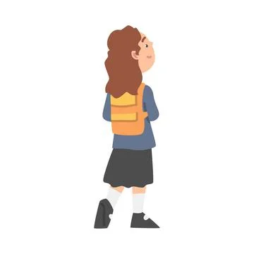
We Cannot Walk Alone Sponsored Walk
We want each child to have an opportunity to take part in a sponsored walk, where, with the rest of the school, they will walk the distance from Kyiv to St Margaret's - a total of 1,421 miles!
Our aim is for children to understand more about the reasons why some people are forced to leave their homes in the hope to find safety elsewhere and the effort it takes to make such a journey.
The money that is raised through the sponsorship will be put towards helping these vulnerable families and to help make a change in their lives.

Slide 12
We Cannot Walk Alone community Enterprise Day
Lastly, to end our event we will be hosting an Enterprise Day which is taking place on Friday 8th July, from 2pm. We hope that you will be able to come and enjoy a great afternoon of entertainment as the classes of St Margaret’s Primary C of E School show their brilliant entrepreneurial skills as they go head to head with their own business ideas to compete to raise money for charity. Bring your purses and wallets and come and be entertained.

Slide 13
Aim
Aim to raise awareness and £3000 for charity to help support those in need.

